Slide 1
Start/Finish PlaceHolder
5 Seconds Each (each slide 10 seconds)

Slide 2
Background
Data Structures can be abused via predictability
Distributed Denial of Service Attacks (DDOS)
Algorithmic DOS
Predictable Timings

Slide 3
Background Cont.
Goal is to create a Data Structure that can’t be DOS’d
Adaptability
Running time must be reasonable.
Assume the Attacker knows the data structure and has unlimited function calls..

Slide 4
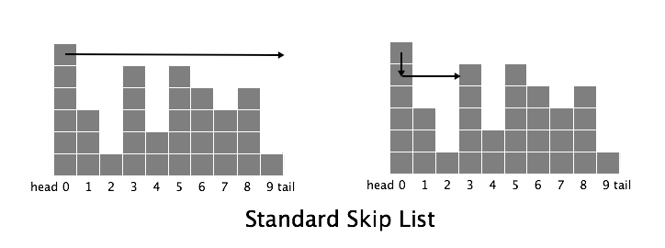
What is our Data Structure
The structure chosen must enable insertion, deletion, and searching.
Basic Level Link Lists
Skip Lists

Slide 5
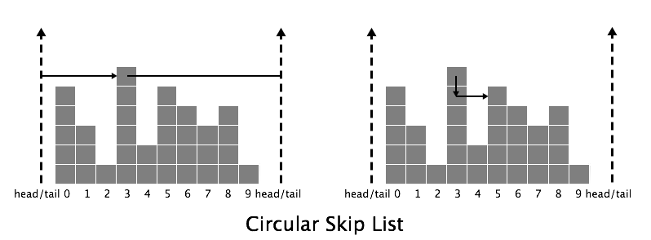
What is our Data Structure 2
Circular Skip Lists
Choosing an Origin
Randomizing Origin

Slide 6
Benefits
Retains Efficiency
Untrackable Probability Distribution
Unpredictable even under attack.

Slide 7
Visualization

Slide 8
List of Operations
Insertion
Deletion
Search
Change Height
Change Origin

Slide 9
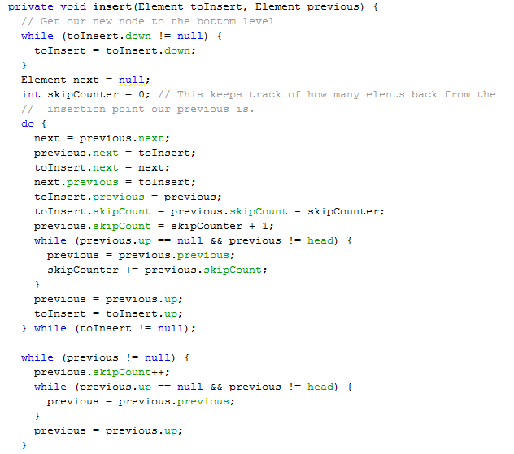
Add Circular

Slide 10
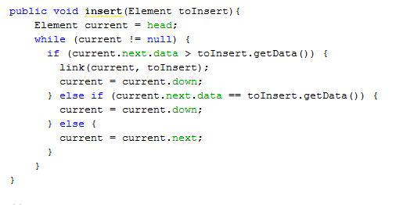
Add Standard

Slide 11
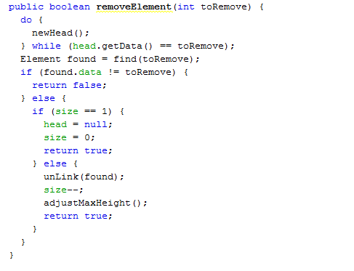
Delete Circular

Slide 12
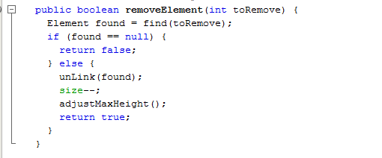
Delete Standard

Slide 13
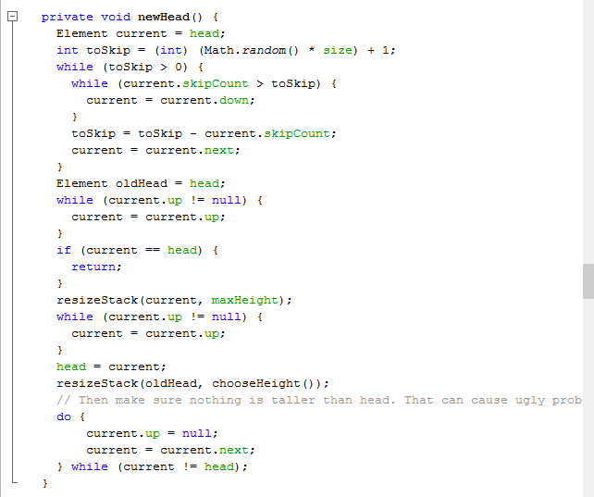
Change Origen

Slide 14
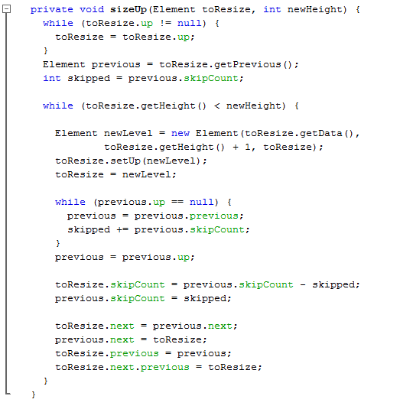
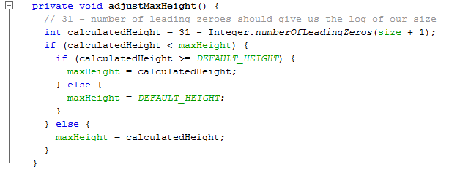
Change Height

Slide 15
Large Scale Visualization
“And after 60,000 additions it looks like this “
Insert sweet picture.

Slide 16
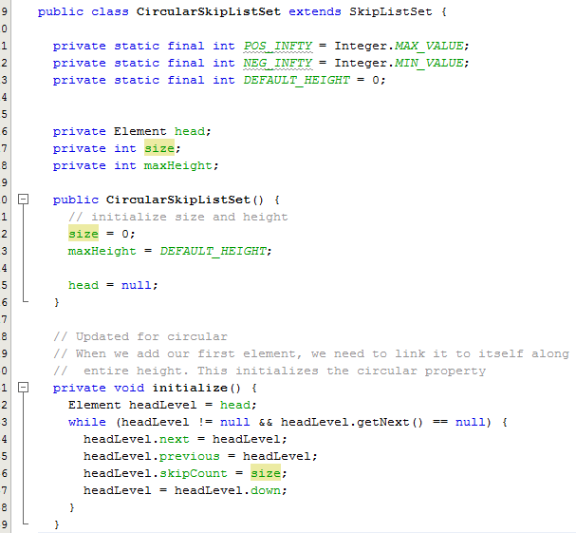
We Programmed It!

Slide 17
Results General
Costs and Benefits of randomized structure in a real example.
Actual Data vs. Theoretical Benefits.
Programming to help Understanding
Results shown via Graphs

Slide 18
Cost of Circular Operations, No Attacker
Unexpected Results for Small Data Sets
Larger Sets with faster searches.
Random Variation + Implementation quirks
Circular 3x Slower under normal operations with no attacker

Slide 19
Benefits of Circular, with Attacker
Timing benefits grow as size of data set grows
Worse than theoretical time but reasonable
Hundreds or even Thousands of time faster when under attack.

Slide 20
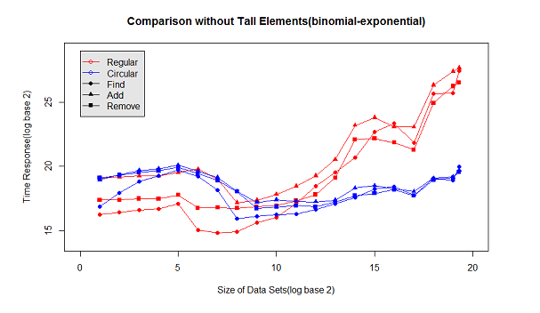
Results

Slide 21
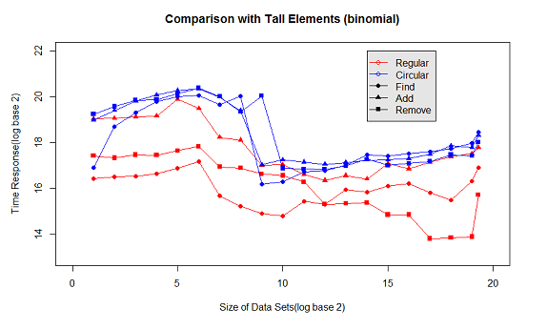
Results Cont.

Slide 22
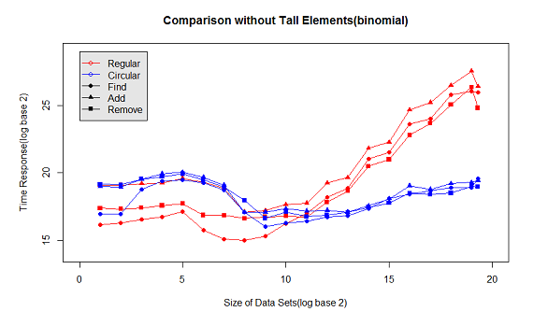
Results Cont.

Slide 23
Our Algorithm vs. Proposed algorithm
Different Searching Methods for simplicity
Tracking by offset rather than indexing
Origen as element instead of constant value
Slight differences in Resizing methods

Slide 24
Frustrations with Implementation
Keeping track of offset through operations
Keeping track of the origin
Resizing in an efficient manner
Transferring methods from standard skip list to circular skip list.

Slide 25
Random Origen vs Circular with Known Origin
Circular Skip Lists can still be abused
Attacking nodes with larger heights
Extremely difficult to accomplish but given the time

Slide 26
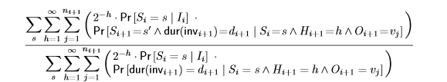
The Equation Necessary

Slide 27
Summary

Slide 28
What we wanted to do, but didn’t
Random normal skip lists.
Analyze timing of Random Circular vs Random Normal
Bring our implementation closer to theoretical implementation in paper.

Slide 29
Further Research on Subject
Testing similar implementation methods with other data structures, for example a Binary tree.
Finding new implementation methods that can help with timing unpredictability.
Exploring real life applications for the concept.

